Slide 1


Copyright © 2020 [Rene & Teddy]

Slide 2
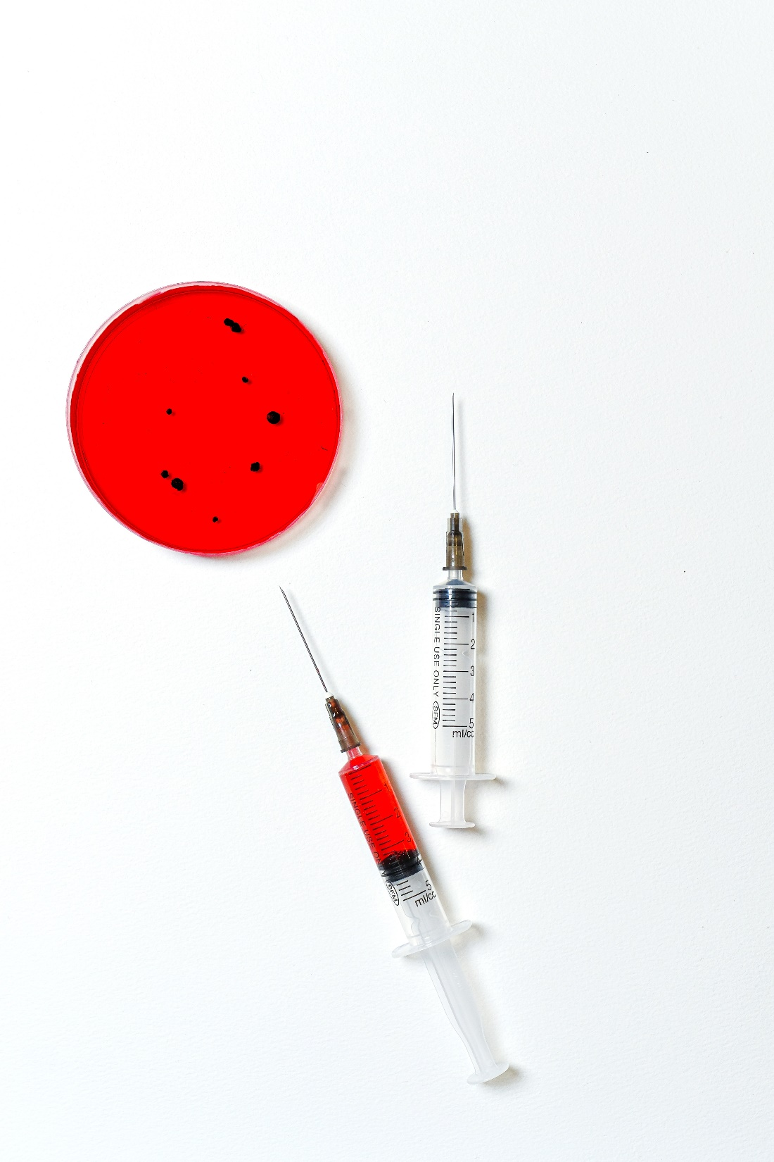
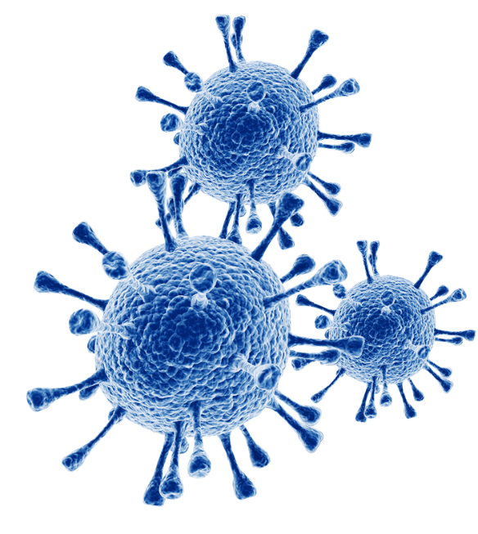
01 Introduction
Pandemic
Makit
02 Time background
Stage 1
Stage 2
Stage 3
Stage 4
03 Characters
Player
Followers
04 Enemy
Stage 1
Stage 2
Stage 3
Stage 4

Slide 3
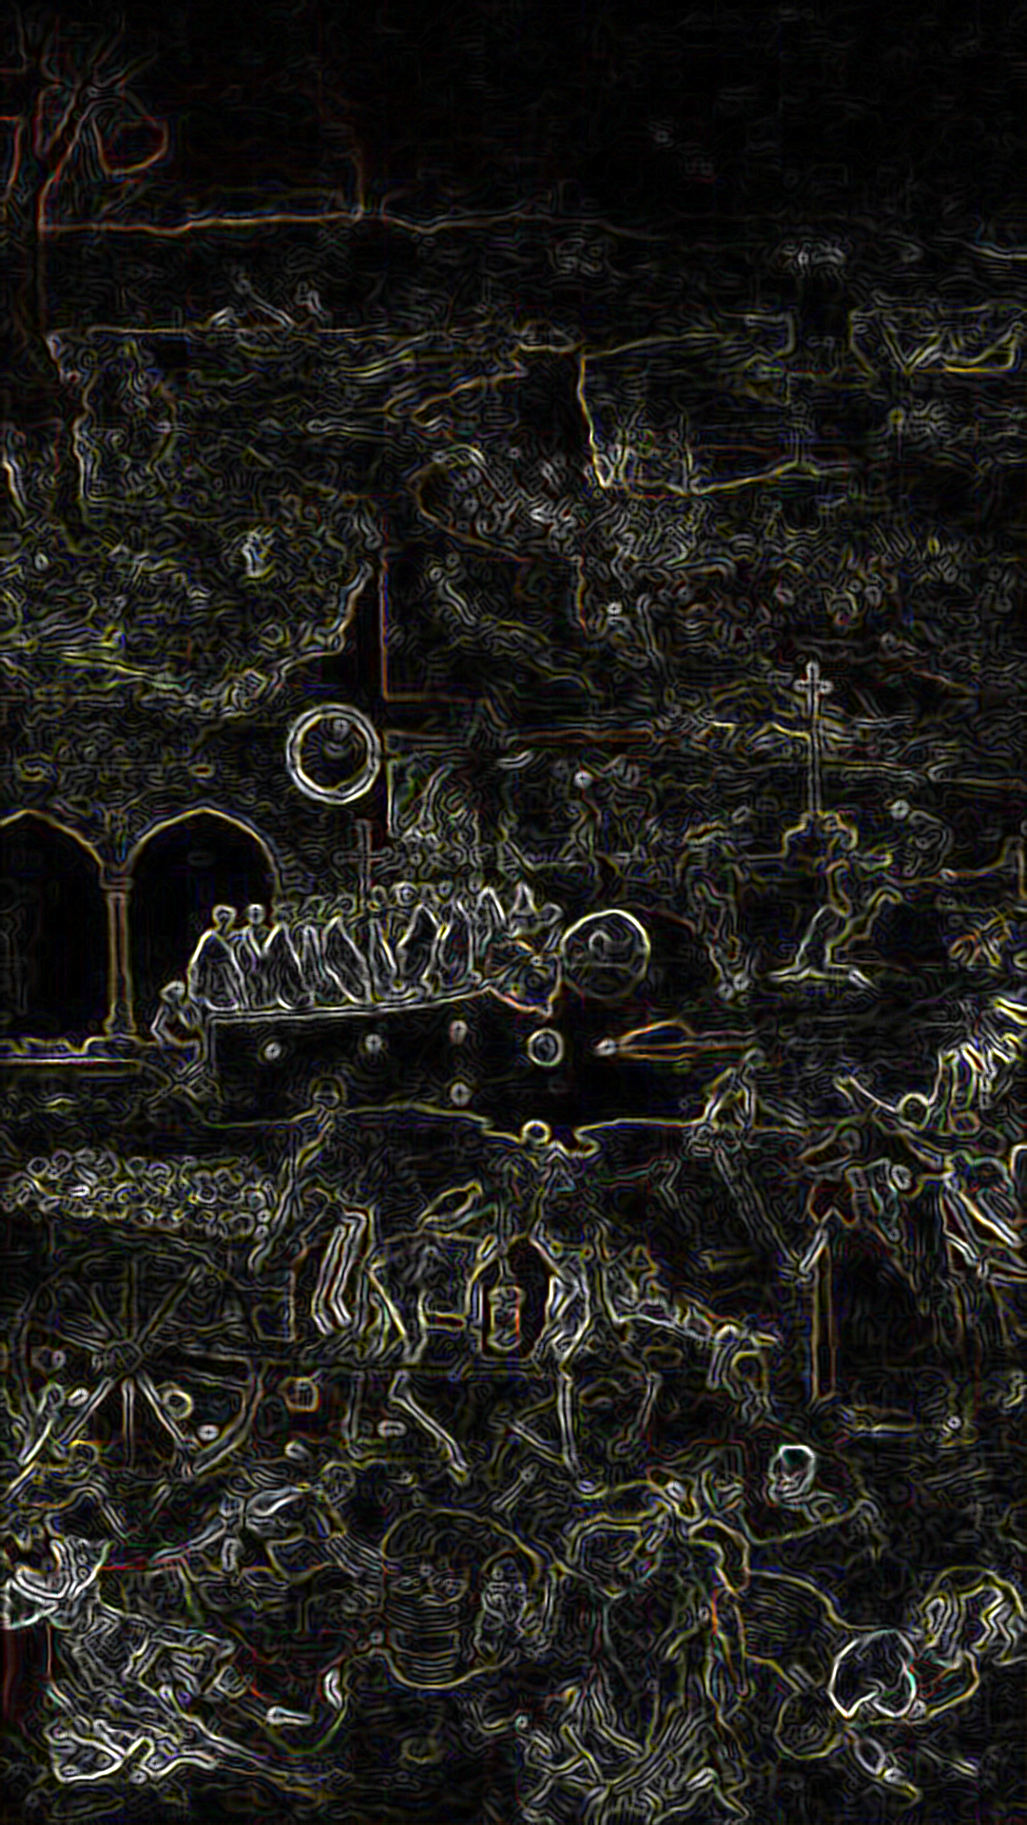
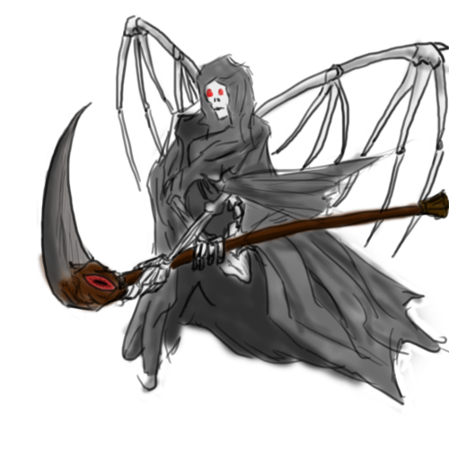
01 Introduction

Slide 4



01 Introduction
- Pandemic
Title: Pandemic
Subtitle: Virus eradication operation
Genre: Clicker
Released on the Google play store in June 2020
https://play.google.com/store/apps/details?id=com.Makit.PANDEMIC

Slide 5


01 Introduction
- Makit
Team Name: Makit
Members:
Rene An
Teddy Eum

Slide 6
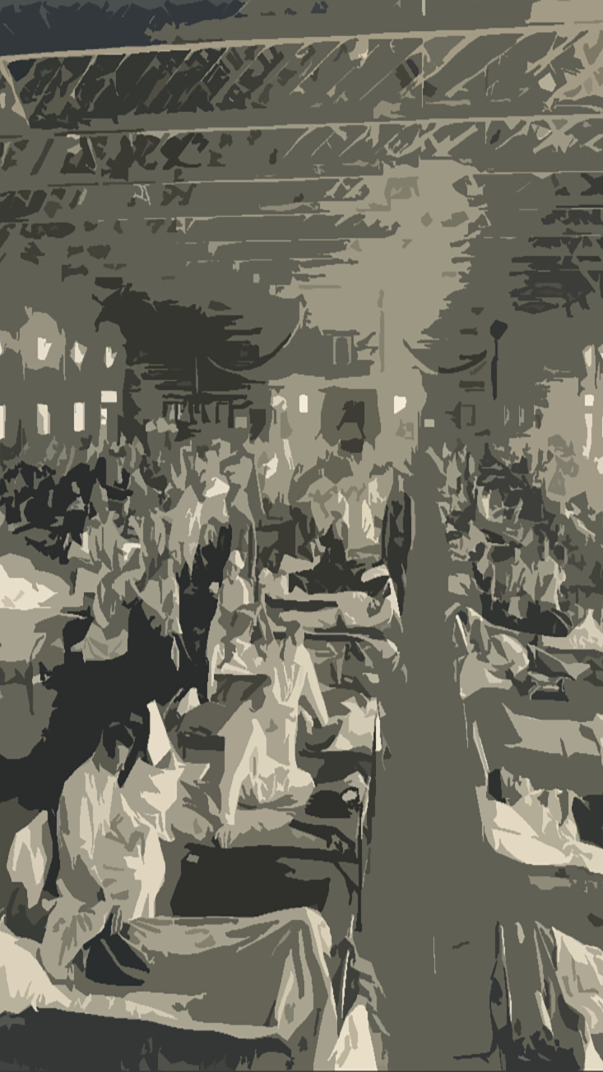
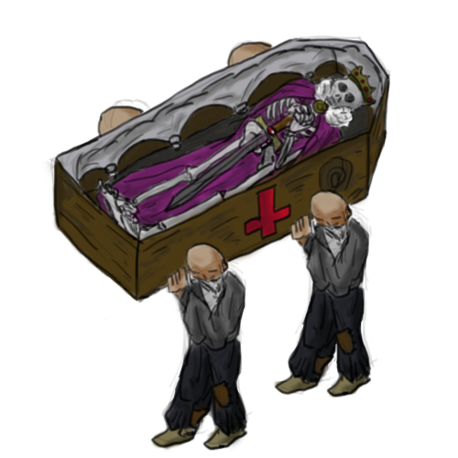
02 Stage

Slide 7
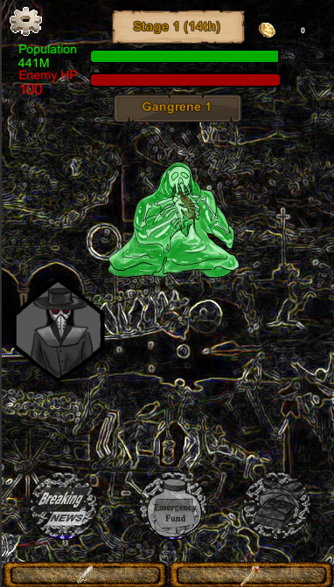
02 Stage
- Stage 1
The Middle Age
Europe in the 14th century
Main virus: Black Death (1342 - 1353)
Global population: 450 million

Slide 8
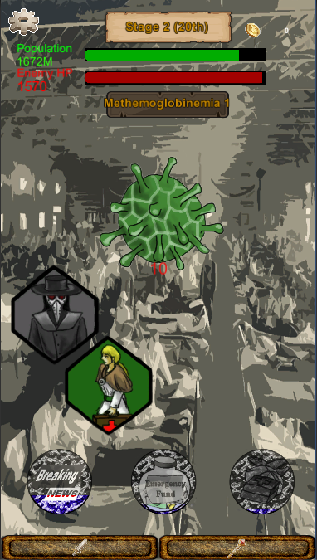
02 Stage
- Stage 2
Modern Period 1
The 20th century
Main virus: Spanish flu (1918 - 1920)
Global population: 200 million

Slide 9
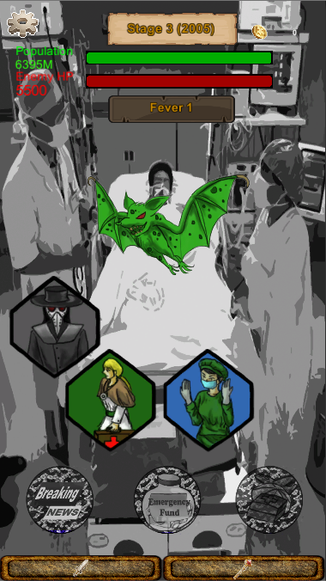
02 Stage
- Stage 3
Modern Period 2
The 21th century
Main virus: SARS (2002)
Global population: 650 million

Slide 10
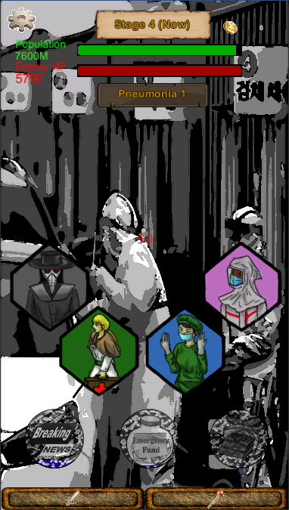
02 Stage
- Stage 4
NOW
The 21th century
Main virus: COVID-19 (2020)
Global population: 800 million

Slide 11
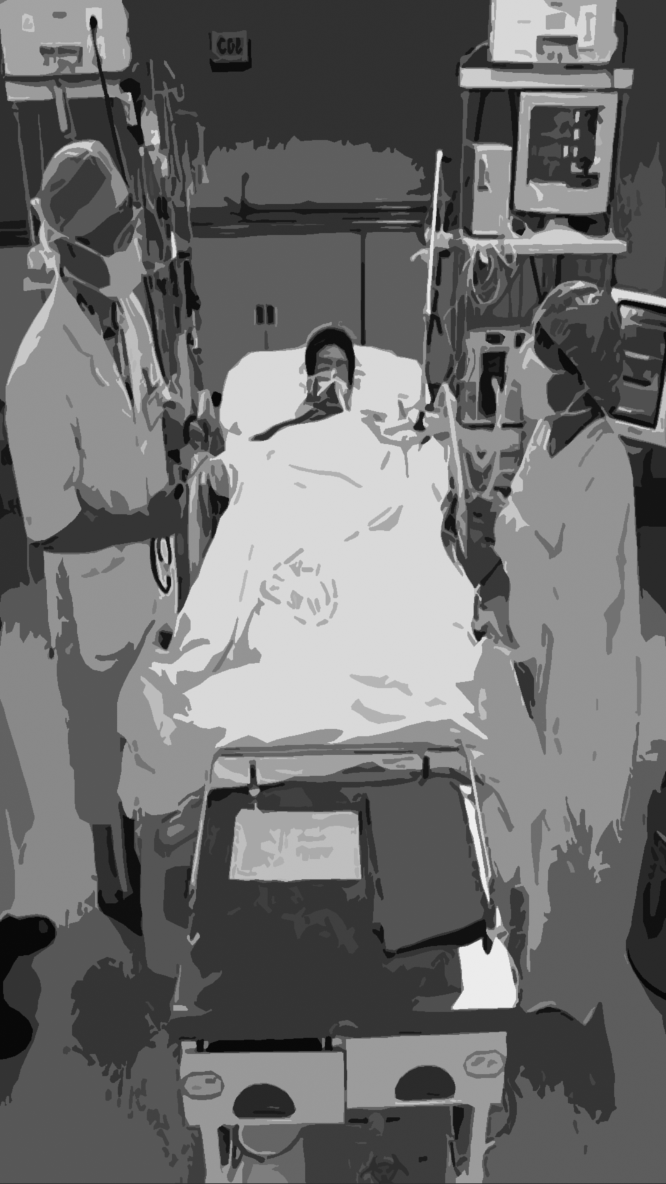
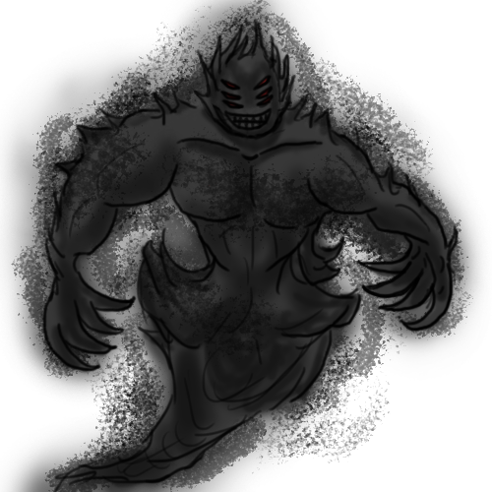
03 Characters

Slide 12

03 Characters
- Player
Player’s HP: Population
Based on the actual number of world population (https://www.worldometers.info/world-population/)
It also functions as a stage timer.
Stage | Describe | Player HP (Timer)
1 (Black Death) | 14th century | 45 million
2 (Spanish flu) | 1927 year | 200 million
3 (SARS) | 01 July, 2005 (6.47 billion people) | 650 million
4 (COVID-19) | 2020 year | 800 million

Slide 13



03 Characters
- Player
2) Player’s Skills
All skills are opened from stage 1
Skill Name | Describe | Reuse Latency | Level up Cost | Skill Damage Level Up | Cost Up
Public anger | Player tab damage |  | $500 | Player damage + 5 | +300
Breaking News | A single blow | 600 sec | $650 | Player damage X (2 +@) | +400
Emergency Fund | Supply from $1,000 | 1000 sec | $700 | + $300 | +500
Medical Supply | HP Supply | 1800 sec | $800 | +10% | +600

Slide 14
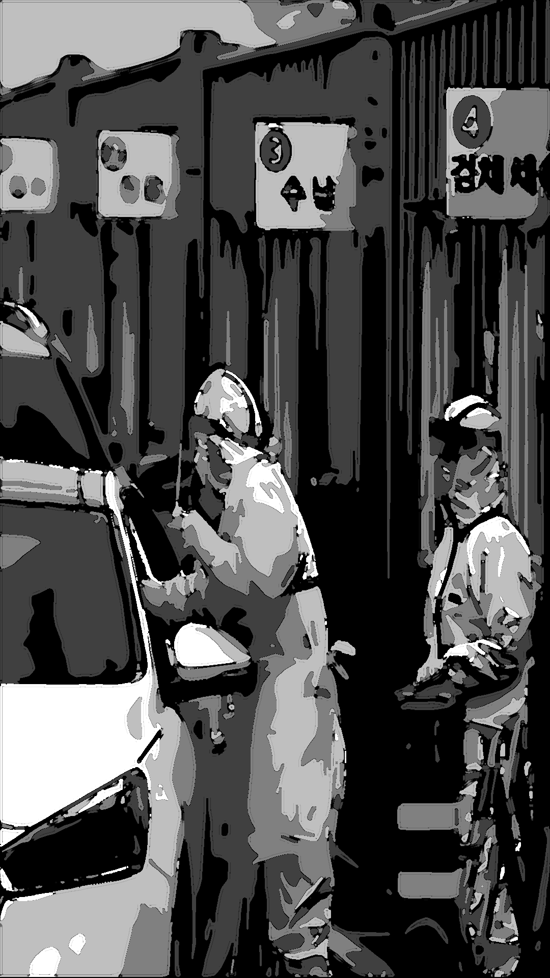
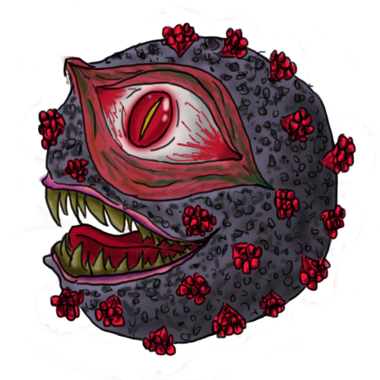
04 Enemy

Slide 15




03 Characters
- Followers
Black Death doctor
Flue doctor
Operating doctor
Veiled doctor
Unlock | Name | Damage | Level up Cost | Damage up | Cost up
Stage 1 | black Death doctor | 10 | 1,000 | +15 | $ 200
Stage 2 | Flue doctor | 20 | 2,500 | +20 | $ 350
Stage 3 | Operating doctor | 50 | 4,000 | +25 | $ 500
Stage 4 | Veiled doctor | 100 | 6,500 | +30 | $ 700

Slide 16
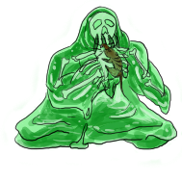
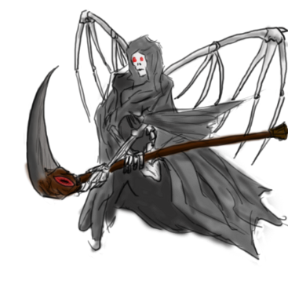
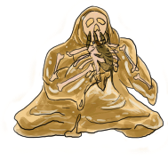
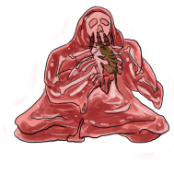
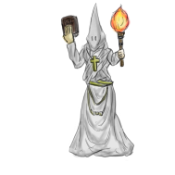
04 Enemy
Stage 1
Enemy Name | Image | HP | Cost | Boss Name | Image | HP | Cost
Gangrene1 |  | 400 | 1000 | Black Death |  | 1500 | 3000
Gangrene2 |  | 700
Gangrene3 |  | 900
Gangrene4 |  | 1100

Slide 17




04 Enemy
Stage 2
Enemy Name | Image | HP | Cost | Boss Name | Image | HP | Cost
Methemoglobinemia1 |  | 1600 | 2000 | Spanish flu |  | 4000 | 3500
Methemoglobinemia2 |  | 2000
Methemoglobinemia3 |  | 2600
Methemoglobinemia4 |  | 3300

Slide 18

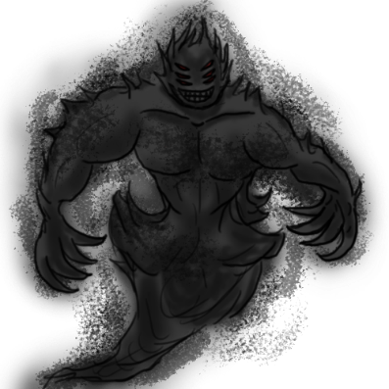
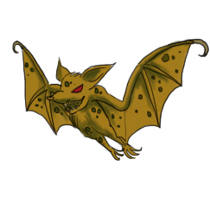
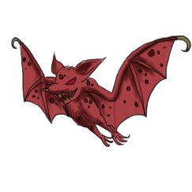

04 Enemy
Stage 3
Enemy Name | Image | HP | Cost | Boss Name | Image | HP | Cost
Fever1 |  | 4400 | 3000 | SARS |  | 6000 | 4000
Fever2 |  | 4800
Fever3 |  | 5200
Fever4 |  | 5600

Slide 19
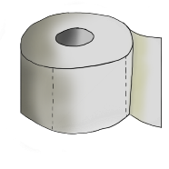

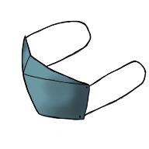

04 Enemy
Stage 4
Enemy Name | Image | HP | Cost | Boss Name | Image | HP | Cost
Toilet paper | 6 | 6400 | 4000 | COVID-19 |  | 9000 | 5000
Hand sanitizer |  | 6700
Mask |  | 7200
Anti-vaccinationists |  | 8000

